Slide 1
Web Scraping Project
Stephen Kita
NYC Data Science Academy
July 28, 2020

Slide 2
CVS Pharmacy
~10,000 stores in the United States, $256B in revenue in 2019
Top sources of income:
Pharmacy sales ($141B) *
In-store sales ($86B)*
Majority of pharmacy sales are within network (in-store)*
Opening new stores is still a viable way to grow revenue.
*CVS Health 2019 10-K SEC Filing.

Slide 3
CVS Pharmacy
Problem Statement:
Opening new stores is a great way to increase revenue, but CVS is running out of new places to open stores.
Value Proposition:
CVS can identify new store locations by targeting areas with higher demand based on population.

Slide 4
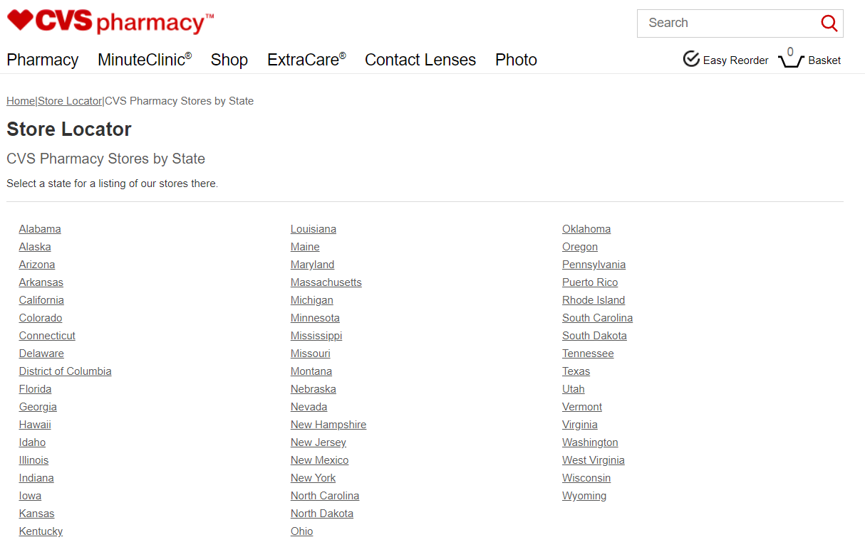
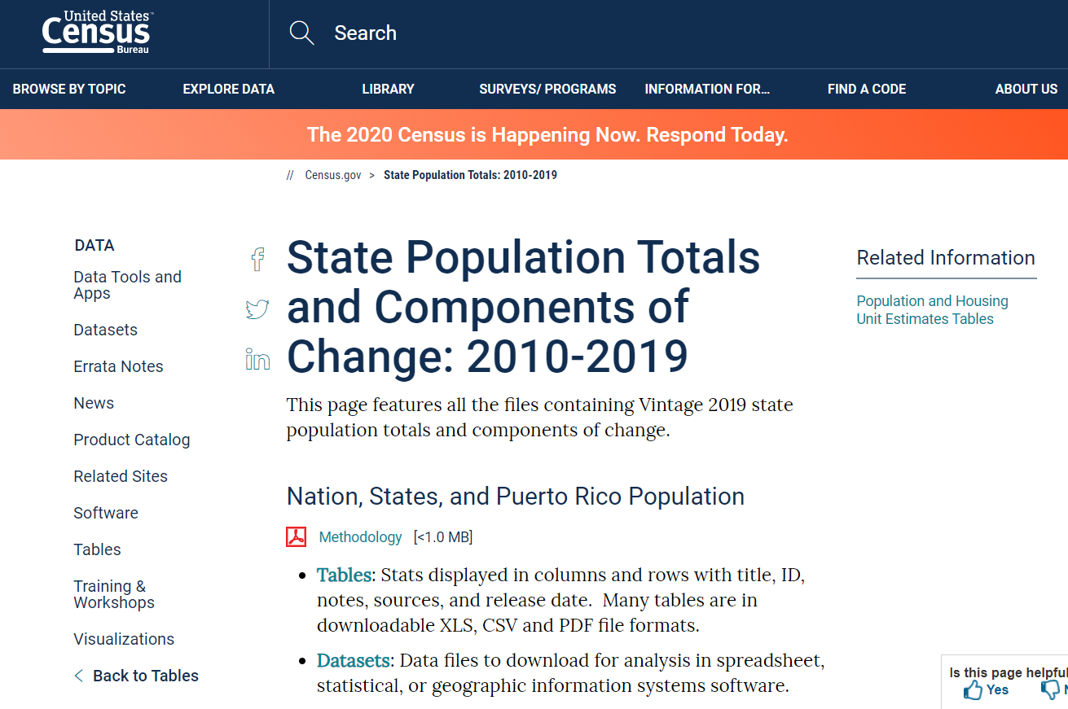
Data Gathering
CVS Store Locations online:
US Census data online:

Slide 5
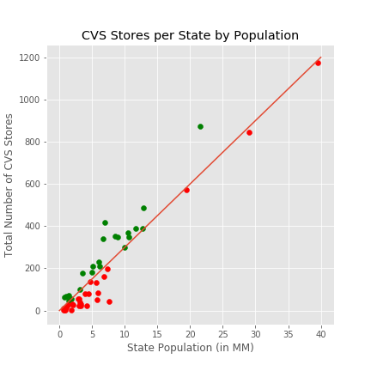
What is the average number of CVS Stores per capita?
On average:
1 CVS / 33,000 people
Green – higher than average number of stores per person
Red – lower than average

Slide 6
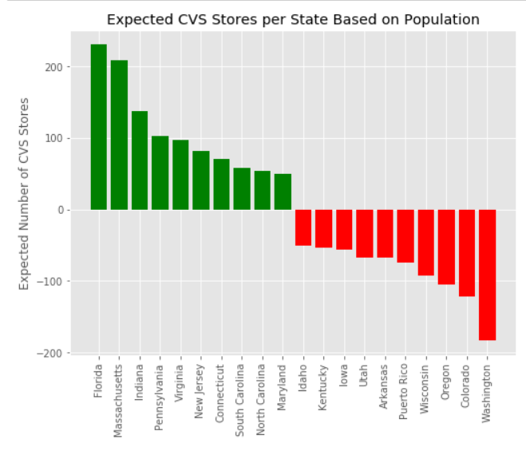
What are the top 10 states above and below average?
Green – higher than average number of stores per person
Red – lower than average

Slide 7
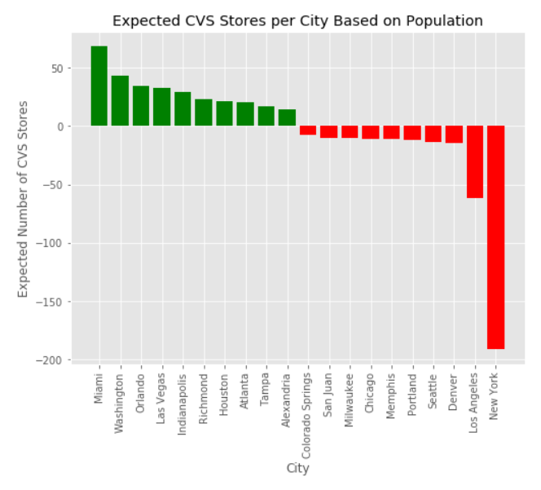
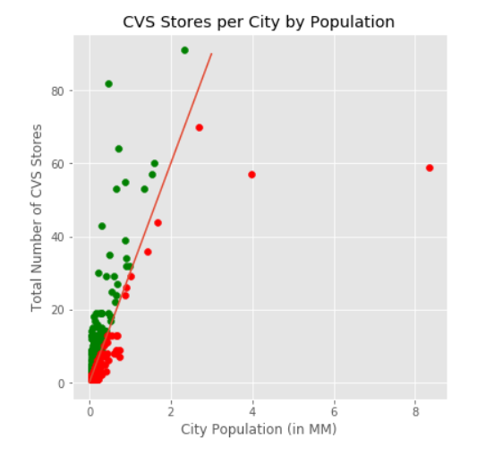
What about by city?
Green – higher than average number of stores per person
Red – lower than average

Slide 8
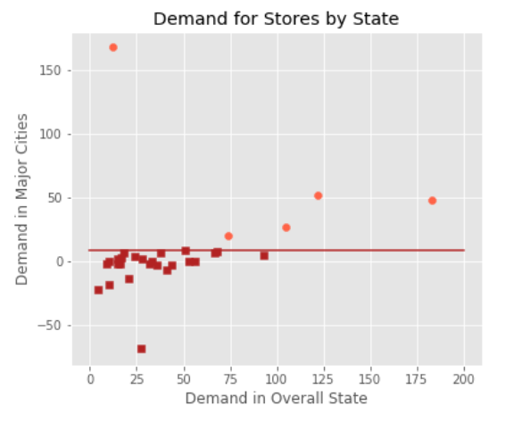
How do below average cites compare with below average states?
Light Red – states below average with high demand in cities
Dark Red – states below average with low demand in cities

Slide 9
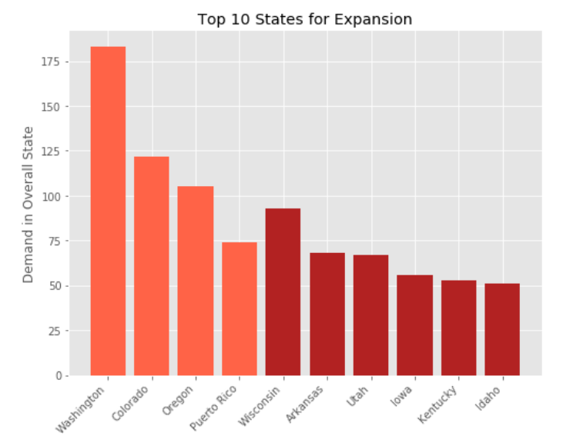
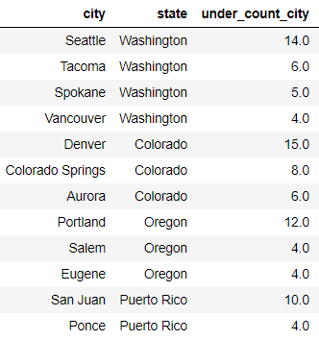
Conclusion
Light Red – states where CVS should expand within current cities
Dark Red – states where CVS should expand into new cities
Top Cities for Store Expansion
Store Demand

Slide 10
Conclusion
Based on the current number of CVS stores per person, CVS still has opportunity to grow new stores
Recommend new stores in these cities:
Seattle, WA
Denver, CO
Portland, OR
San Juan, PR
Recommend new cities in these states:
Wisconsin
Arkansas
Utah
Iowa

Slide 11
Thank you

Slide 12
Competitor Analysis
Walgreens facts
Walgreens financials

Slide 13
Competitor Analysis
Highlight cities where walgreens has less than expected presence

